Slide 1
Heuristic Evaluation: The City of Vancouver Government Website
Prepared by: Mia Itri

Slide 2
◌Executive Summary
This report was created following a heuristic evaluation of the City of Vancouver Government website wherein evaluators completed task that real life users may need to accomplish both as residents and visitors of the city. Using Nielsen’s Ten Usability Heuristics, the site was evaluated while goal tasks were performed.
As a result of the evaluation, findings were gathered and compiled to assess the positive and negative traits of the site per Nielsen’s heuristics and recommendations were provided. Below are selected highlights of both positive and negative findings.
Highlighted Positive Findings
The site makes use of bread crumbs to assist users as they journey through multiple screenflows.
Presenting users with key information highlighted at the top of a page creates an efficient and convenient experience for users.
Highlighted Negative Findings
Menu styles and locations should remain consistent throughout the site.
Filter options should work together and not cancel each other out when applied.
Menus should be free of superfluous information and should be organized in a logical fashion.

Slide 3

◌ Introduction
In an effort to better understand and improve the user experience on the City of Vancouver government website, a heuristic evaluation was conducted using two evaluators who were asked to perform two tasks: a task that a resident of the city of Vancouver might perform, and a task that a person who will be visiting the city of Vancouver might perform.
Each evaluator was given specific protocol to follow with specific task goals set for them to accomplish. In the process of accomplishing their goals, the evaluators were asked to evaluate the entire experience using set heuristic guidelines.
After the evaluations were completed, the data was compiled to detail specific areas of success and those needing improvement of user experience, followed by recommendations for the improvement of overall user experience when engaging with the website as both a resident of the city of Vancouver or a potential visitor to the city of Vancouver.

Slide 4
Methodology
Heuristic Framework & Evaluation Protocol

Slide 5
◌ Heuristic Framework Used in this Evaluation: Nielsen’s 10 Usability Heuristics for Interface Design & Numerical Error Rating Scale
Heuristic Framework
Visibility of system status
Match between system and the real world
User control and freedom
Consistency and standards
Error prevention
Recognition rather than recall
Flexibility and efficiency of use
Aesthetic and minimalist design
Help users recognize, diagnose, and recover from errors
Help and documentation
Numerical Rating Scale
0= not a usability problem
1=minor usability problem
2=clear usability problem
3=major usability problem, important to correct
4=extreme usability problem, must correct in order to permit use

Slide 6
◌ Evaluation Scenarios & Tasks Given to Evaluators: Using the Site as a Vancouver Resident & Visitor
Task 1: Vancouver Resident Task
Task 2: Vancouver Visitor Task
Scenario: You are a resident of the City of Vancouver and need to report that the traffic signal on your street is not working.
Use the “Find it Fast” menu to report your traffic signal outage
Locate the option of what you “want to” do→ you want to “Report Street, Signals or Sidewalk Problems”
Navigate to the page to report street, signals or sidewalk problems
Navigate to the form to report the issue
Do not fill out the form
Navigate BACK to the home page, but do NOT use your browsers “back” button
Scenario: You are visiting the City of Vancouver and want to find out about some upcoming events happening while you are there.
Using the “Recreation & Events” link, go to the calendar of events
Go to the February Calendar and find the “VOLUNTEER- Winter Fruit Tree Pruning” event
Choose that event and go to it’s page
Find the RSVP email link (do not actually RSVP)
You change your mind and want to find another event – navigate BACK to the home page, but do NOT use your browsers “back” button
Find the “Visit Vancouver” button and click it
Find the “Events” tab and go to “Seasonal Events” and choose “Spring” Events
Choose “month” view and set the calendar dates to February 1- February 28
Click Search and view Calendar of Events
Choose First Friday Night Market
Find the link and visit First Friday Night Market website
Find and visit the “About” page to find out the location and time of the event

Slide 7
◌ Findings Summary Table for Task 1&2 Combined
 | H1 Visibility of System Status | H2 Match between System and the Real World | H3 User Control and Freedom | H4 Consistency and Standards | H5 Error Prevention | H6 Recognition Rather than Recall | H7 Flexibility and Efficiency of Use | H8 Aesthetic and Minimalist Design | H9 Help users recognize, diagnose, and recover from errors | H10 Help and Documentation
Number of Positive Findings | 1 | 0 | 2 | 1 | 0 | 0 | 0 | 0 | 0 | 0
Number of Negative Findings | 1 | 2 | 3 | 5 | 3 | 2 | 5 | 2 | 0 | 0
Total Number of Findings | 2 | 2 | 5 | 6 | 3 | 2 | 5 | 2 | 0 | 0

Slide 8
Detailed Positive Findings Walkthrough

Slide 9
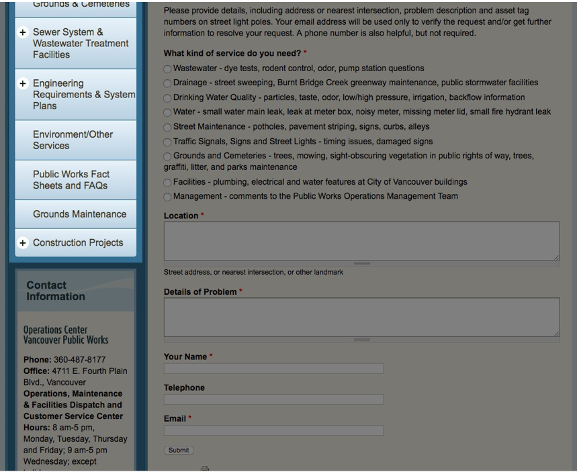
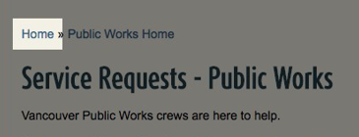
◌ Detailed Positive Findings for Task 1: Vancouver Resident Task
Heuristic 3: User Control and Freedom
Heuristic 4: Consistency and Standards
+ The use of breadcrumbs on the site allows users to return to their starting point without having to use their browsers back button.
+ Having the menu on the left side of the page follows standard conventions of most common menu locations.
Following standard conventions allows users to navigate the site easier because they know what to expect.
Leaving breadcrumbs as shown lets users retrace their steps back to a previous page.

Slide 10

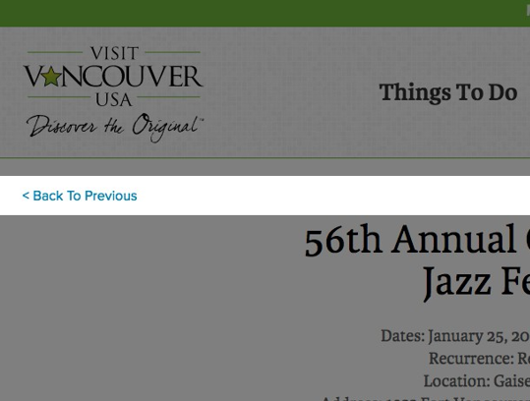
◌ Detailed Positive Findings for Task 2: Visiting Vancouver Task
Heuristic 1: Visibility of System Status
Heuristic 3: User Control and Freedom
+ The user is presented with important information on the top of the page, allowing them to avoid needing to navigate or scroll down the page.
+ Proper use of navigation links allow users to go back to the previous screen without using their browsers back button.
Easy back/undo functions allow users to navigate a site more easily and effectively.
Users want important information to be easily accessible.

Slide 11
Detailed Negative Findings Walkthrough

Slide 12
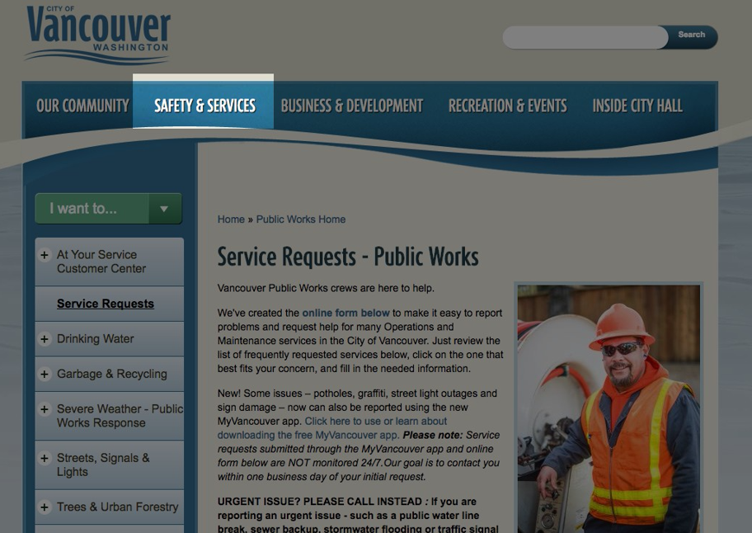
◌ Detailed Negative Findings for Task 1, Heuristic 1: Visibility of System Status
H 1.1 Severity Rating: 2
The site has a persistent top navigation bar and makes use of breadcrumbs, but it does not indicate to the user what page they are on per the navigation bar.
On a site with multiple pages or tabs, the user needs verification of what page they are currently on.

Slide 13
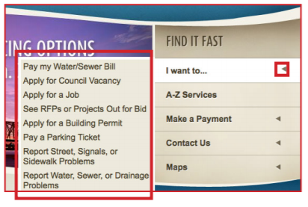
◌ Detailed Negative Findings for Task 1, Heuristic 2: Match Between System and Real World
H 2.1 Severity Rating: 2
The fly out menu under the quick use Find it Fast → I want to: menu appears on the left of the stationary menu which violates the users natural reading direction order.
The user will expect a menu to appear on the right side, rather than the left and will have to alter their regular left to right reading direction when scanning the menu at first glance.

Slide 14
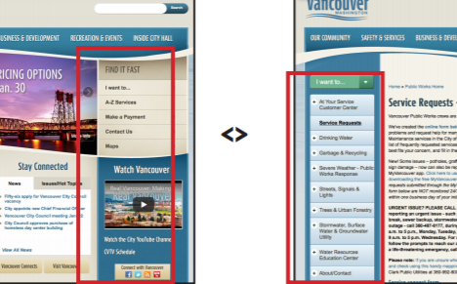
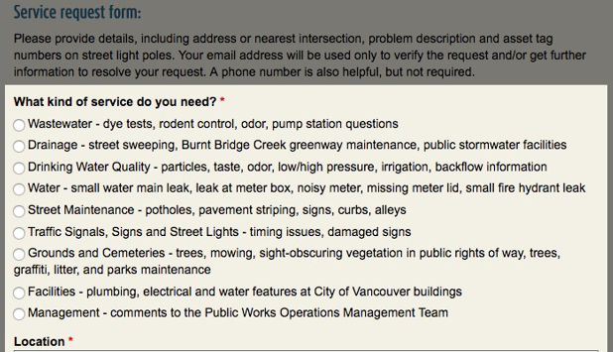
◌ Detailed Negative Findings for Task 1, Heuristic 4: Consistency and Standards
H 4.1 Severity Rating: 3
H 4.2 Severity Rating: 3
Although the user selected the “Find it Fast Street Signal….” option, on the form, it still needs to be selected again from a long list of options.
Menu locations, styles and colors differ dramatically between pages.
Users should not have to make their selection multiple times in multiple locations.
Menus lacking consistency across a single site can cause user confusion.

Slide 15
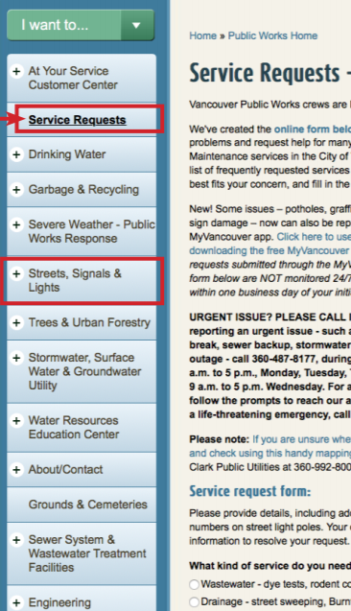
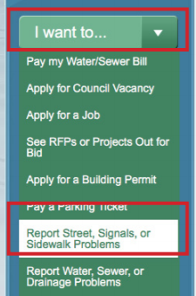

◌ Detailed Negative Findings for Task 1, Heuristic 5: Error Prevention
H 5.1 & 5.2 Severity Rating: 2
H 5.3 Severity Rating: 3
The form does not check if a phone number or email address entered is valid or prompt for valid phone number or email format.
The service request page menu has confusing options; it is unclear which to click to allow user to accomplish their goal of reporting a street signal issue.
Not having validation checks for phone number and email may allow a user to unknowingly enter an invalid number or email.
Unclear menu options create user confusion.

Slide 16

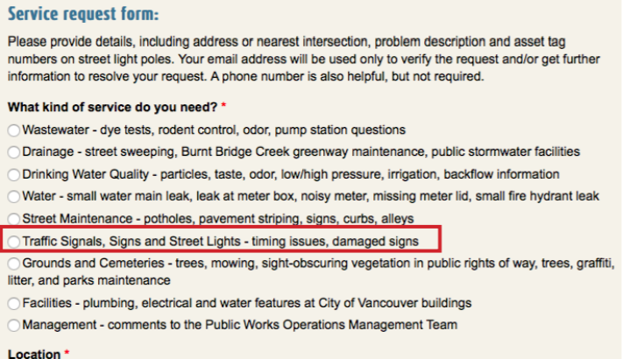
◌ Detailed Negative Findings for Task 1, Heuristic 6: Recognition Rather than Recall
H 6.1 Severity Rating: 2
H 6.2 Severity Rating: 3
Navigation menus are usually on the top or left side of a page, so having the “Find it Fast” menu on the right side may slow users down.
When selecting an option from an initial menu, the user should not have to select the same options again on their destination page.
The user may not intuitively look for a menu on the right side of the page when accustomed to left or top menus.
The user should not have to select their choice from the form when they already selected it on the previous menu.

Slide 17
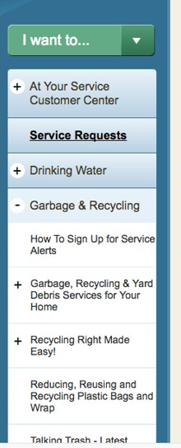
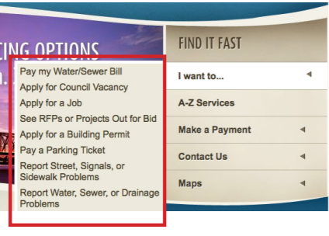
◌ Detailed Negative Findings for Task 1, Heuristic 7: Flexibility and Effiency of Use
H 7.1 Severity Rating: 2
H 7.2 Severity Rating: 2
While this section provides users with options (Fast Selection or More Options), this may confuse users or present information they do not need.
The “I Want To” menu under the Find it Fast section contains too many options in the sub-menu and those options are presented in an arbitrary order.
Providing the user with ample options is beneficial, but having too many options located in one menu can be overwhelming or create unnecessary confusion for the user.
Menu items should be organized in a logical fashion that makes sense to the user.

Slide 18
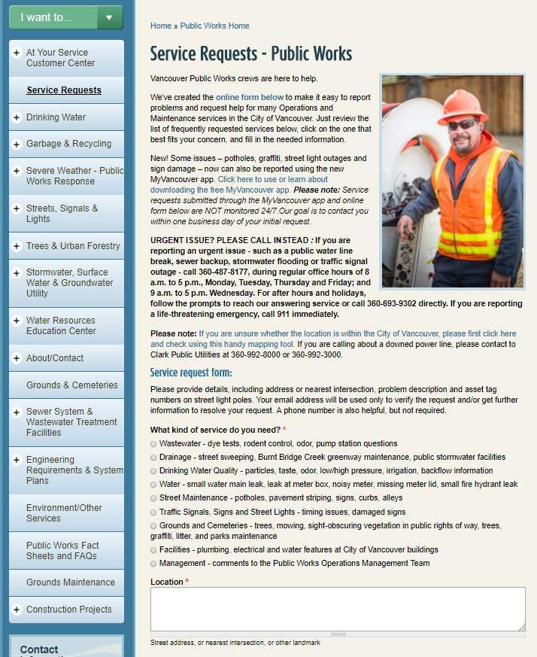
◌ Detailed Negative Findings for Task 1, Heuristic 8: Aesthetic and Minimalist Design
H 8.1 Severity Rating: 2
After the user selects the option to “report street, signal and sidewalk issues,” the website presents too much information up front to the user before they get to the form they need in order to accomplish their goal.
The user is immediately met with a lengthy wall of text and an overwhelming amount of information which they must choose to either read, skim, or skip and scroll entirely past before they are able to accomplish their goal task of filling out the problem report form. A user may feel overwhelmed or not see the form needed at all below the text.

Slide 19
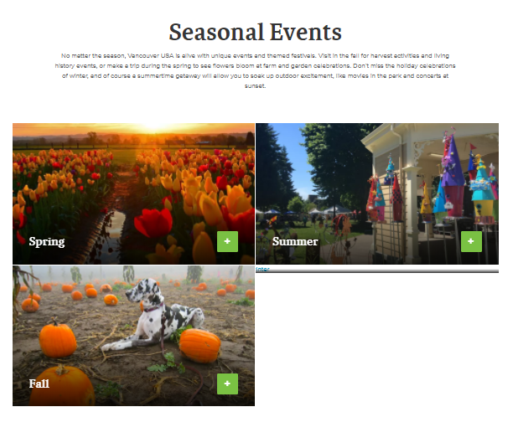
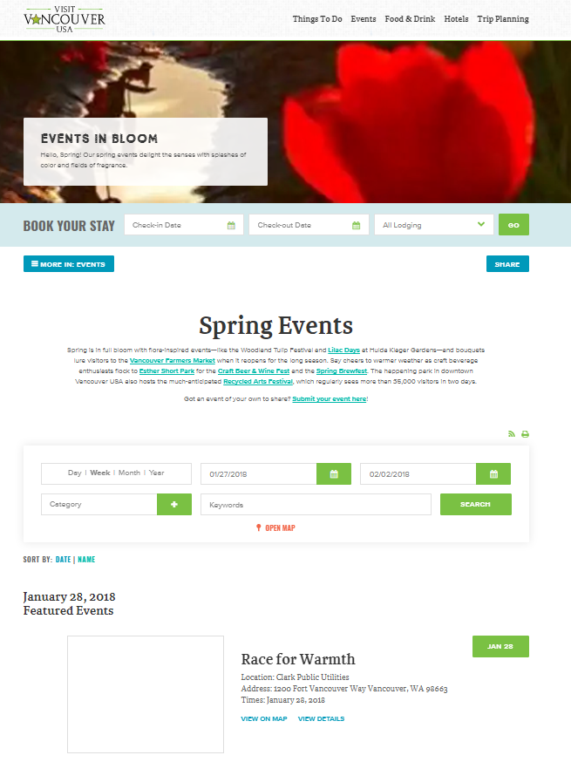

◌ Detailed Negative Findings for Task 2, Heuristic 2: Match Between System and Real World
H 2.1 Severity Rating: 3
The user has selected “Spring” events, but the calendar still displays the current January/Winter events regardless of the users selection.
The user expects that by clicking “Spring” events, the calendar will display Spring events, but instead, their action is not reflected in any way on the website’s calendar results page.

Slide 20

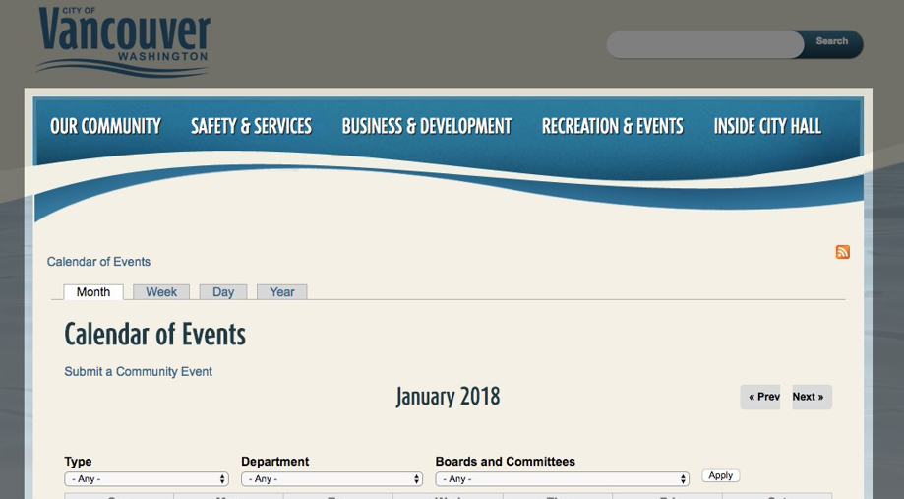
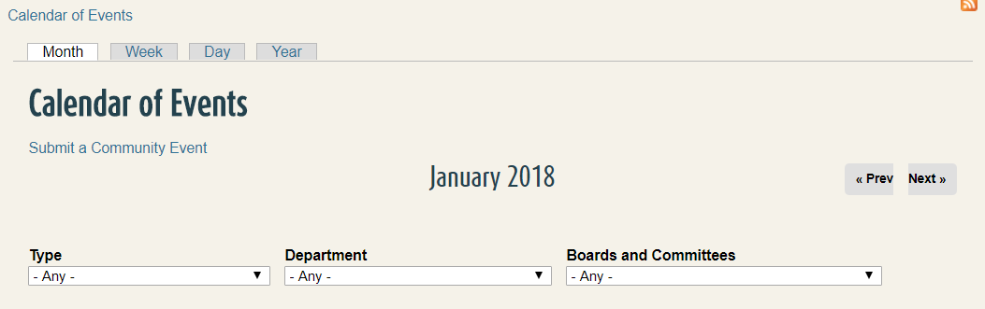
◌ Detailed Negative Findings for Task 2, Heuristic 3: User Control and Freedom
H 3.1 Severity Rating: 2
H 3.2 Severity Rating: 3
There is no intuitive way for the user to return to the starting point from the page without clicking on the browser back button or site logo which returns the user all the way back to the home page.
When the user reaches an event for February, they’re presented with a navigation link back to the calendar, but clicking this link resets the calendar dates back to the current month.
The site reverts the calendar back to the current date rather than taking the user back to the selected month as they would expect to happen when clicking the Back to Calendar button.
The user should be presented with a way to navigate to the previous page without having to rely on their browser back button.

Slide 21
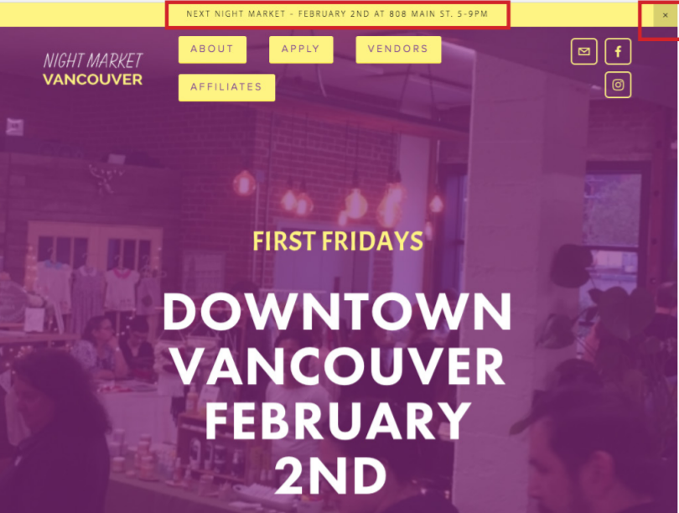
◌ Detailed Negative Findings for Task 2, Heuristic 3: User Control and Freedom
H 3.3 Severity Rating: 2
Critical event information on the home page of the Night Market page is displayed in the yellow header bar, however, if the user clicks the “x” on the bar, there is no way to bring the bar back, and the information is not located anywhere else on the main home page.
If the user clicks the “x” without realizing this closes the entire bar, they must then explore the site in order to find out where and when the market is. This information is only found under the about page once the yellow header bar is closed.

Slide 22


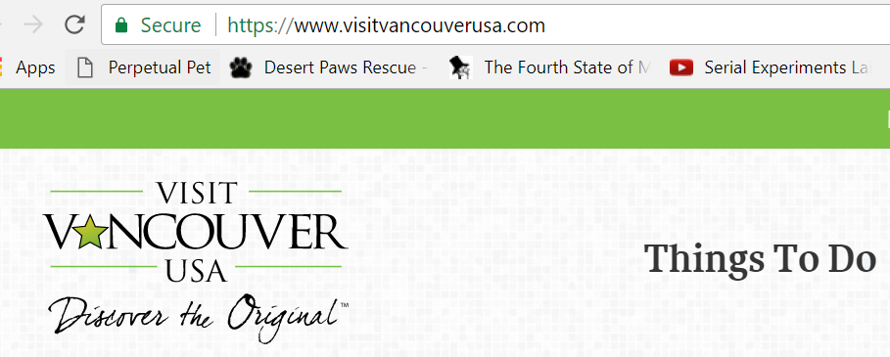
◌ Detailed Negative Findings for Task 2, Heuristic 4: Consistency and Standards
H 4.1 Severity Rating: 2
H 4.2 Severity Rating: 2
The “Visit Vancouver” button on the main page has the same appearance as other buttons and looks like it will take the user to another page of the same site, but takes the user to an external site.
The address of the Night Market differs slightly on the “About” page from the yellow header banner.
When presenting the user with important information pertinent to the event, consistency and accuracy of information in all places is imperative. While the information is essentially the same, the address still differs which can mislead the user.
The site does not give the user any warning that clicking the button will take them to an external site.

Slide 23
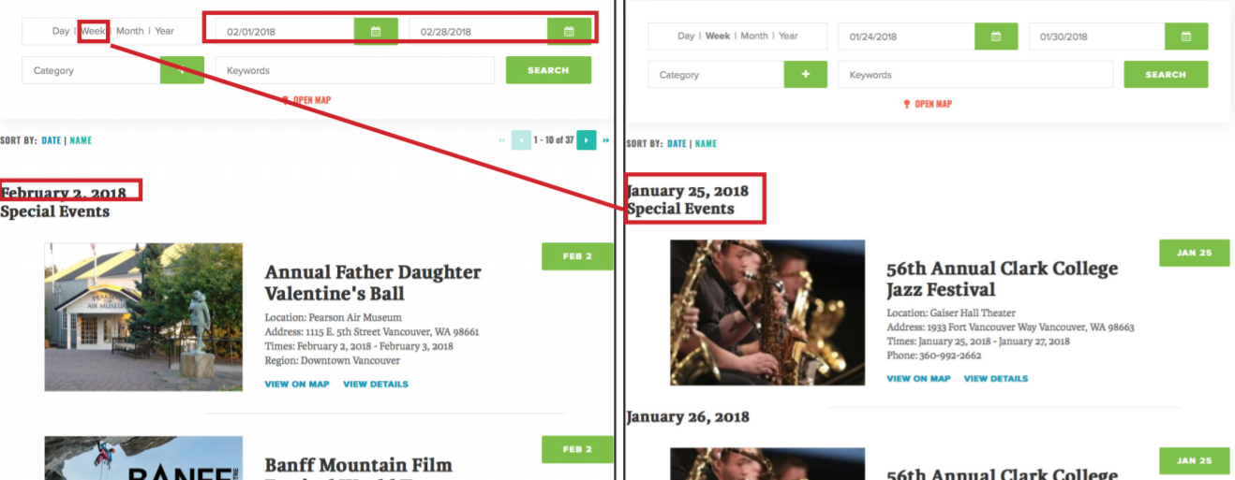
◌ Detailed Negative Findings for Task 2, Heuristic 4: Consistency and Standards
H 4.3 Severity Rating: 2
The calendar event date range selection and week view filters do not work together; the user can select specific dates from the date range filters, and then click “week view,” but the calendar will show events for the current week, not a week within the selected date range.
When the user selects a date range from the date filter, the user will assume that this filter will be applied for whatever calendar view option they choose; however, instead clicking week view returns the user back to the current week rather than the week view within the date ranges that the user selected.

Slide 24
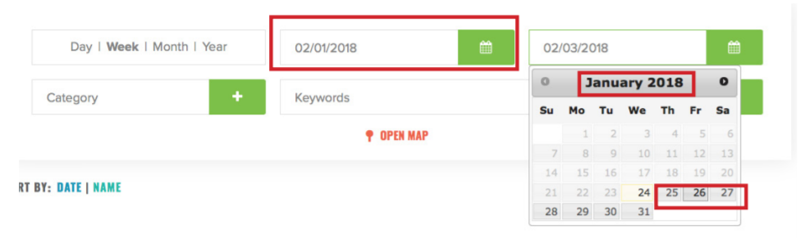
◌ Detailed Negative Findings for Task 2, Heuristic 5: Error Prevention
H 5.1 Severity Rating: 1
v
When selecting dates for the date range on the calendar, the user can select an end date from the calendar that is before the start date they selected from the calendar.
The user is able to select dates from the calendar that are not sequentially valid; there are no system checks to prevent the user from selecting a date range that is not sequentially correct and no system messages appear if the user makes an invalid date selection.

Slide 25
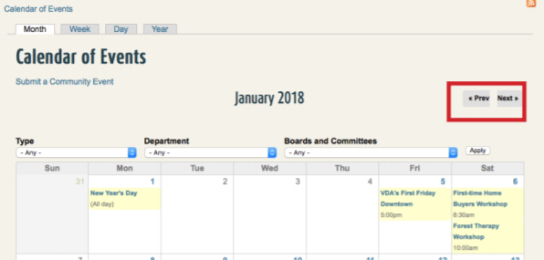
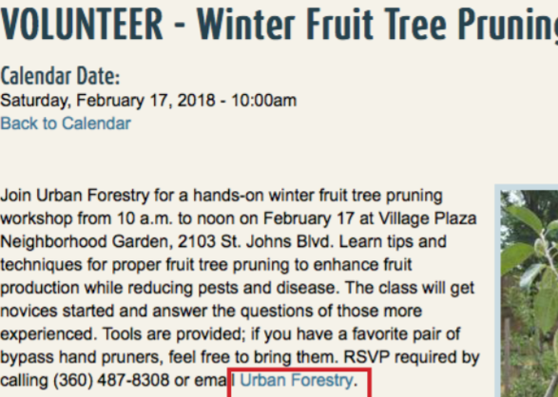
◌ Detailed Negative Findings for Task 2, Heuristic 7: Flexibility and Efficiency of Use
H 7.1 Severity Rating: 2
H 7.2 Severity Rating: 3
The calendar doesn’t allow the user to quickly or efficiently jump to a month; they must instead click through each month sequentially.
The selected “Winter Fruit Tree Pruning” event does not make it easy for the user to obtain the contact email to RSVP for the event; instead, the user must click the hyperlink, which opens the user’s default email application and only then can the user obtain the email address.
Having a calendar without the ability to quickly jump to a month can frustrate the user and cause them to have to spend an unnecessarily long time just navigating to their desired month.
Not having the RSVP email address accessible and visible can be frustrating to users.

Slide 26
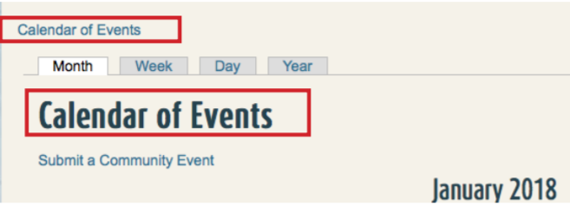
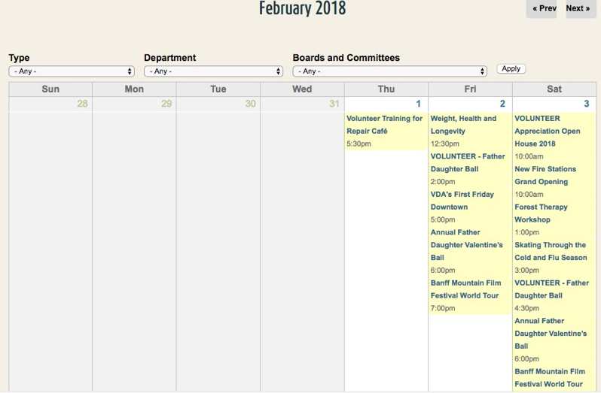
◌ Detailed Negative Findings for Task 2, Heuristic 8: Aesthetic and Minimalist Design
H 8.1 Severity Rating: 3
H 8.2 Severity Rating: 1
The calendar has no easy way to distinguish different types of events without scanning or filtering events from the drop down menu.
“Calendar of Events” is displayed twice in nearly the same location.
Displaying the title Calendar of Events is an unnecessary added piece of information when the clickable link for the Calendar of Events is displayed directly above where the title is written on the page.
Having no differentiation between events on the calendar can be confusing/frustrating for users.

Slide 27
◌ Task 1 & 2 Combined Recommendations Summary Table

Slide 28
◌ Recommendations Task 1:
H 1.1: Indicate to the user what page of the menu/tabs that they are currently on.
H 2.1: Align menus on left side of the page with fly out menus on the right to maintain user expectations.
H 4.1: Carry over users’ selection from page of a form or menu to the next to streamline their experience.
H 4.2: Streamline the appearance of menus on the site to maintain visual consistency.
H 5.1: Create system checks for valid phone number input on user forms.
H 5.2: Create system checks for valid email address input on user forms.
H 5.3: Simplify menus and minimize the number of similar sounding options on the menu list.
H 6.1: Align menus on the left to maintain user consistency.
H 6.2: Save users’ selections from one screen to the next as they go through a form.
H 7.1: Simplify menus to streamline the user’s experience.
H 7.2: Simplify menus to streamline the user’s experience and present menu items in a logical, non-arbitrary manner.
H 8.1: Present important forms that the user need at the top of the page rather than below lengthy text blocks.

Slide 29
◌ Recommendations Task 2:
H 2.1: Match site functions to user expectations, i.e. if the user clicks “spring events” the calendar should display spring events.
H 3.1: Include a button or link for the user to return to the previous page without having to rely on browser back button
H 3.2: Save user choices from filters, i.e. if the user is viewing an event from the February calendar, the “back to calendar” function should return them to February, not the current month.
H 3.3: Provide critical information that users need in places that the user can not accidentally close and then not be able to recover.
H 4.1: Give the user warnings or clues when they will be navigating away from the current site to an external site by clicking a button or link.
H 4.2: Ensure that key information is correct and consistent all times it appears on a site.
H 4.3: Ensure that calendar date filters work together and do not cancel each other out when the user selects more than one viewing option.
H 5.1: Prevent users from accidentally selecting non-sequential date ranges from the calendar.
H 7.1: Allow users to jump forward or backward to a specific month or date.
H 7.2: Display important contact information directly on the webpage.
H 8.1: Differentiate calendar events using color/space or clear dividers.
H 8.2: Omit unnecessary information by displaying “Calendar of Events” only once on the page.

Slide 30
◌ Conclusion
The evaluation revealed several issues and violations of the heuristic framework of varying severity, as well as several positive findings on the site. Recommendations were made to remedy issues found in order to improve the user experience across all violations regardless of level of severity. Through applied recommendations and addition future testing afterwards, the user experience is expected to be both streamlined as well as improved overall for both resident related tasks and visitor related tasks carried out through the City of Vancouver Government Website.
◌ References
Nielsen, J. 10 Usability Heuristics for User Interface Design. 2013

